Slide 1
Weekly Progress
Master thesis
Gabriel Vallat

Slide 2
27/09/22
Summary:
Stability as a DCSP
Graphical interface
Problem set-up

Slide 3
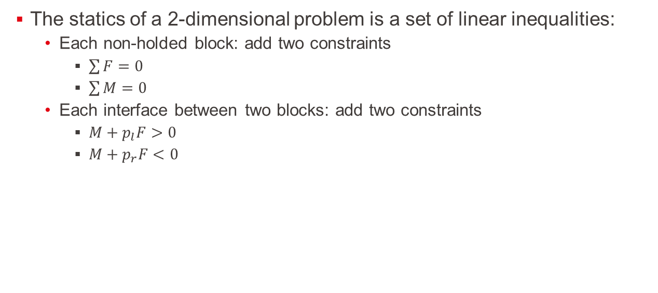
Stability as a DCSP
The statics of a 2-dimensional problem is a set of linear inequalities:
Each non-holded block: add two constraints
$\sum{F}=0$
$\sum{M}=0$
Each interface between two blocks: add two constraints
$M+p_{l}F>0$
$M+p_{r}F<0$

Slide 4
Stability as a DCSP
Example:

Slide 5
Stability as a DCSP
Example:

Slide 6
Stability as a DCSP
Linear constraints
Can be solved by several algorithms
Cassowary algorithm:
Allows to dynamically add and remove constraints.
Pure python => probably slower
Gekko:
Interface building models in binary from the constraints, using different types of solvers
Would need extensive tests, but probably faster

Slide 7
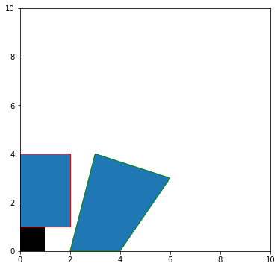
Basic plotting capabilities:
A small script allows the plotting of the blocks:

Slide 8
Problem set-up
The environment will contain:
R robots:
Actions can be:
Release a block:
Add the constraints regarding a free block to the system
Sum of forces and torque must be 0
Remove the constraints regarding the hold block
Max torque and force applied
Pick a block from a list and create interfaces at a chosen location in its range
N blocks:
A block is defined by 4 corners
It has a constant density, and its center of mass can then easily be computed
Each free block add 2 constraints to the static system
Each hold block add 2 slack constraints
Each block has at least 1 interface between either the ground or another block

Slide 9
Problem set-up
The environment will contain:
I interfaces:
The interfaces link together the side of a block with a side or corner of another block
Each interface add either 2 constraints to the system in case of side-side interface, or only 1 in case of side-corner interface
The list:
Needed to describe the possible action of the robots.
Contains a set of possible blocks that the robots can pick from, and the number of remaining block of the corresponding shape
Ideas:
The list contains exactly the right number of blocks needed for a structure
The list contains infinitely many blocks of each type

Slide 10
Problem setup
R ranges:
Each robot has only a subset of the plane accessible to lay the blocks
This range would need to be later better described, and consider the kinematic of the robot as well as the blocks already placed in the structure
For now, it will simply be a circle, with a fixed radius and centre
It could later also define the max force and torque appliable.

Slide 11
Next step:
Start to implement the constraint solver
Look into the creation of interfaces
Look into the handling of collision
Find a way to discretise the action space of the robots:
How to make it able to find placement like the following:

Slide 12
04/10/22
Interface definition
Update in simulation

Slide 13
Interface definition
3 types:
Slide
Lock
Mixed

Slide 14
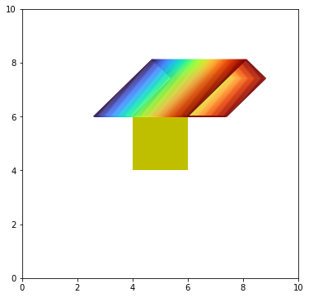
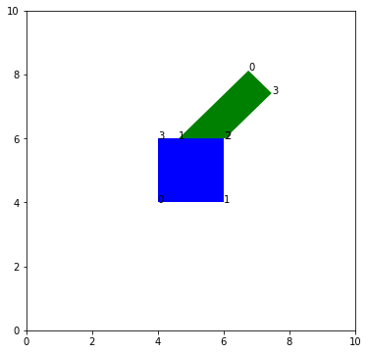
Update in simulation:
A block can be placed using a sliding interface:
Without specifying the free variable
Specifying the free variable (x=0.6)

Slide 15
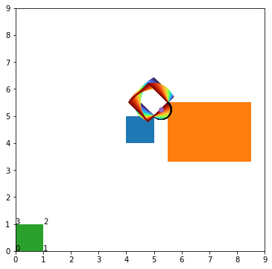
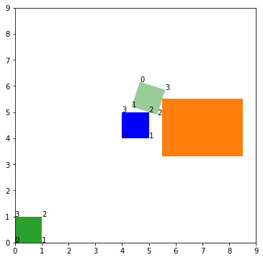
Update in simulation:
A block can be placed using a hanging interface:
This kind of interface would allow to manufacture arbitrary angles
The intersection of the blocks is much more complicated to find
Without specifying the free variable
Specifying the free variable (x=0.3)

Slide 16
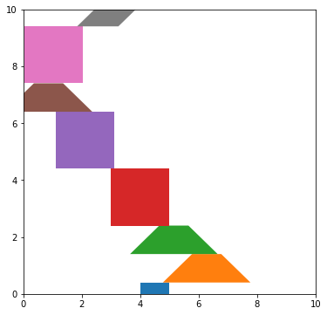
Adding the block is easy
In this scenario, the blocks come from two types and are added randomly on top of the others

Slide 17
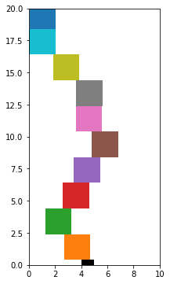
Adding the block is easy
In this one, square blocks are put on top of one another

Slide 18
Questions
Should it be possible to remove blocks?
Would the hanging interface be useful
Same question for the mixed interface
Discretization:
Clean idea:
Each action is composed of a sequence of 3 subactions:
Chose a block from the list
Chose which face to put against which face
Chose an offset: A number between 0 and 1, roughly discretized, where 0 means the new block touches an obstacle on the left and 1 means it touches an obstacle on the right
(Maybe) Problem: reduce the ability to generalize from interface to interface

Slide 19
Question about the intersection
How to handle these cases:
Discontinuous valid x

Slide 20
Next steps
Implementing the intersections of the flat surfaces
Implementing the physics in the simulation

Slide 21
11/10/22
Intersection and contact points
Discussion about the action/observation sets

Slide 22
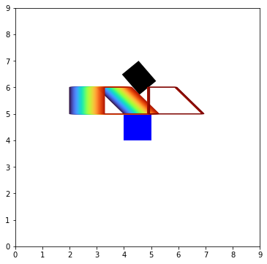
Contact points

Slide 23
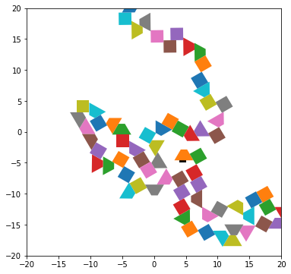
Contact points
Now the blocks does not overlap when put at random
Takes ~1s to place 100 blocks
scales in O(n²)
Without the physics
Can still be optimized by not checking for intersection with all the blocks

Slide 24
Action set
Idea: it takes 3 sub-actions to put a block
Hold or put
Chose a block
Chose two faces
Chose an offset
Chose if keep holding

Slide 25
Action set
New blocks
Idea: it takes 3 sub-actions to put a block
Start holding
Chose a block
Chose two faces
Chose an offset
Keep the block

Slide 26
Action set
New block
Idea: it takes 3 sub-actions to put a block
Chose a block
Chose two faces
Chose an offset
2
3
1
0
5
8
6
2
7
4
3
1
0

Slide 27
Action set
New block
Idea: it takes 3 sub-actions to put a block
Chose a block
Chose two (valid?) faces
Chose an offset
2
3
1
0
5
8
6
10
9
2
7
4
3
1
0

Slide 28
Action set
Idea: it takes 3 sub-actions to put a block
Chose a block
Chose two valid faces
Chose an offset:
A number between 0 and 1
X=0

Slide 29
Action set
Idea: it takes 3 sub-actions to put a block
Chose a block
Chose two valid faces
Chose an offset:
A number between 0 and 1

Slide 30
Action set
Idea: it takes 3 sub-actions to put a block
Chose a block
Chose two valid faces
Chose a (valid?) offset:
A number between 0 and 1
Without the validity check:
X=1

Slide 31
Action set
Idea: it takes 3 sub-actions to put a block
Chose a block
Chose two valid faces
Chose a (valid?) offset:
A number between 0 and 1
With the validity check:
X=1

Slide 32
Action set
About the valid offset:
An interface can have different valid regions
Leads to discontinuity
X=k
X=k+ε

Slide 33

Action set
About the valid offset:
An interface can have different valid regions
Leads to discontinuity
If x is to be discretised, might be good to add some inputs:
Formally: $x∈\left\{\frac{i}{n};i ≤n;i,n∈ℕ^{+},\right\}∪\left\{k;k+ε\right\}$
X=k
X=k+ε

Slide 34
Action set
Can be stored in a dynamic tree

Slide 35
Action set: discretised state space
Can use a triangle grid instead:
Limited in the shapes
Only 60 or 120 degrees angles are possible

Slide 36
Observation set
First point: Does the second robot knows if the first one is holding a block?
Two different amount of information:
Corners
Corners structured
(knowing which corner they are connected to)
Corners + contact points
Value of the forces applied on a block?

Slide 37
18/10/22
Switch to discrete
Triangle grid and possible scenarios
Change in equilibrium calculation

Slide 38
Switch to discrete
Problems with continuous:
Describing the actions would have been dynamic and growing linearly with the number of blocks
Each face would require to test whether or not the last action changed its parameter

Slide 39
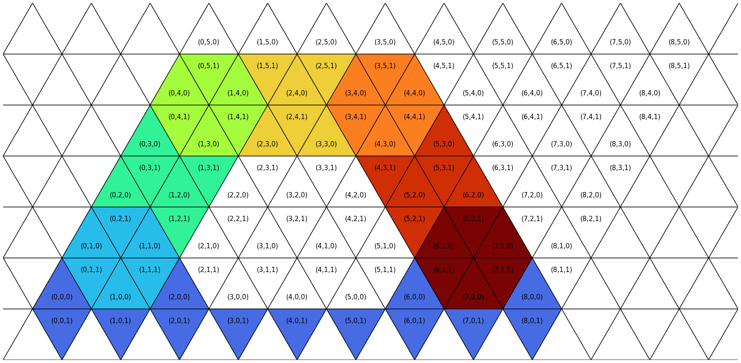

Switch to discrete
Idea: replace the quadrilateral blocks by a grid equilateral triangles
Only ${6n}_{type block}x_{max}y_{max}$ possible actions

Slide 40
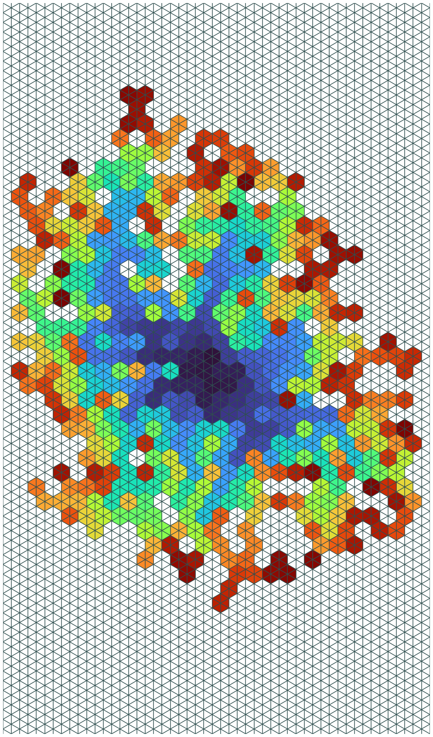
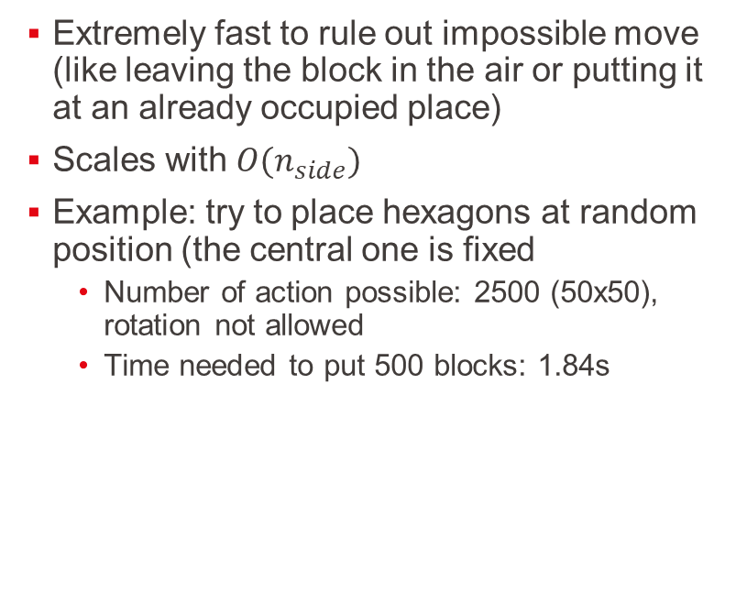
Switch to discrete
Extremely fast to rule out impossible move (like leaving the block in the air or putting it at an already occupied place)
Scales with $O(n_{side})$
Example: try to place hexagons at random position (the central one is fixed
Number of action possible: 2500 (50x50), rotation not allowed
Time needed to put 500 blocks: 1.84s

Slide 41

Possible scenarios
Use two types of blocks: hinge and link
Try to build arches with different terrains

Slide 42
Possible scenarios
Use only hexagonals
Start with a full terrain
Remove blocks so the other robot make the structure collapse

Slide 43
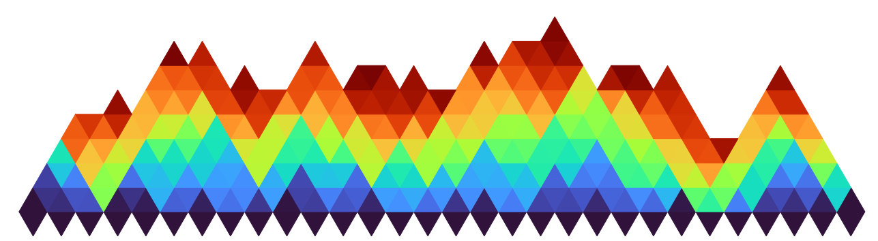
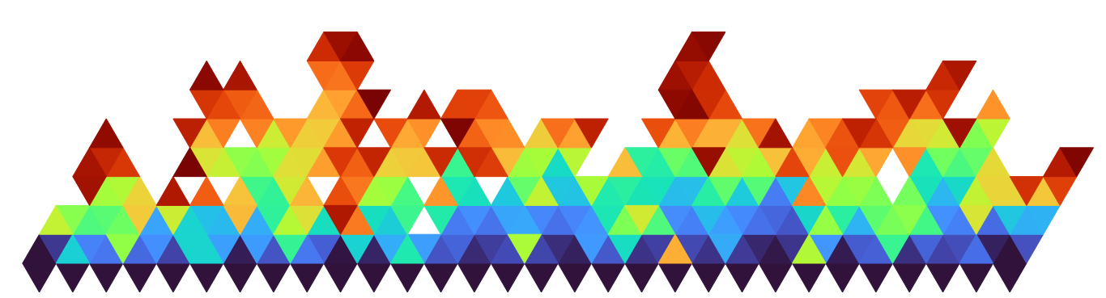
Equilibrium
Optimization library not usable:
Time taken to build the model is too long (constant 3s)
Whereas the solving time is only 0.025s
Try a non-sequential approach with SciPy:
Works quite well:
300 blocks at random on a (30x20) grid:
Takes ~53s but
Put at random
Much more complicated problem to solve

Slide 44
Equilibrium results
With the equilibrium test (53s):
Without the equilibrium test (1.38s):

Slide 45
25/10/22
Game description

Slide 46
Game elements
Agents
Action set
Observation set
States
States transition
Reward
Finishing state

Slide 47

Agents
$N_{r}$ robots
Action set:
$𝔸=\left\{P_{H},P_{L},H\right\}$
$P_{H}$: Put and hold
Let go any block it is holding
Put a new block
Hold it
$P_{L}$: Put and Leave
Let go any block it is holding
Put a new block
$H$: Hold
Go hold an already placed block

Slide 48

Agents
$N_{r}$ robots
Action set:
$𝔸=\left\{P_{H},P_{L},H\right\}$
$P_{L}$ or $P_{H}$: Put
Chose a block from a list
Chose its orientation among 6
Chose the location of its reference point

Slide 49

Agents
$N_{r}$ robots
Observation set:
Consider the game as open information: $𝕆=𝕊$

Slide 50
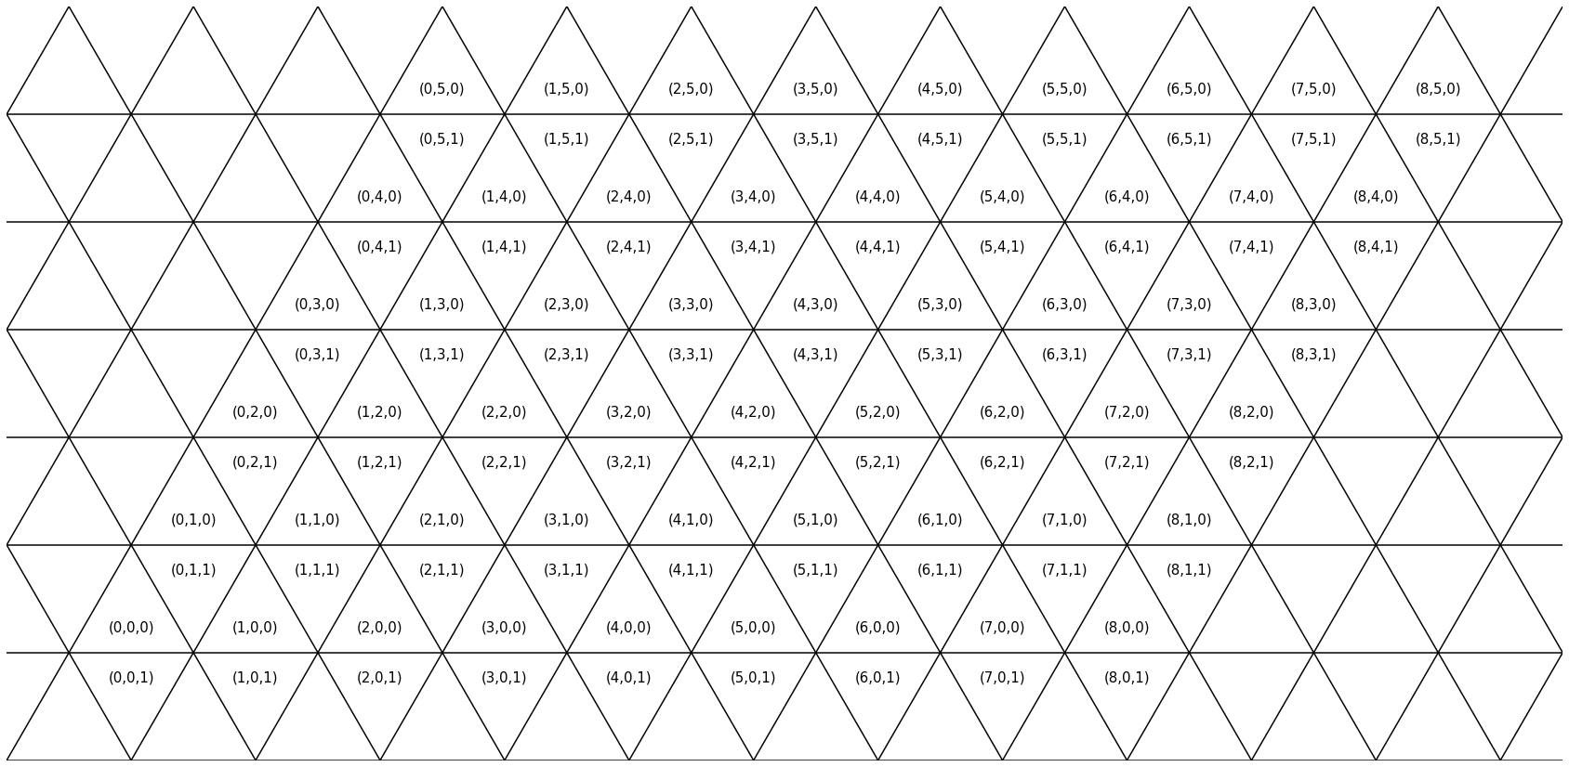

States
Grid: $𝔾=\left\{\left(x,y,d\right) ∈ℕ^{2}×\left\{0,1\right\} | 0<x<x_{max} and 0<y<y_{max}\right\}$
$x,y$: coordinates of the leftmost corner of a triangle (using isometric base)
$d$: (=down) is equal to 0 if the triangle is pointing up, 1 otherwise

Slide 51
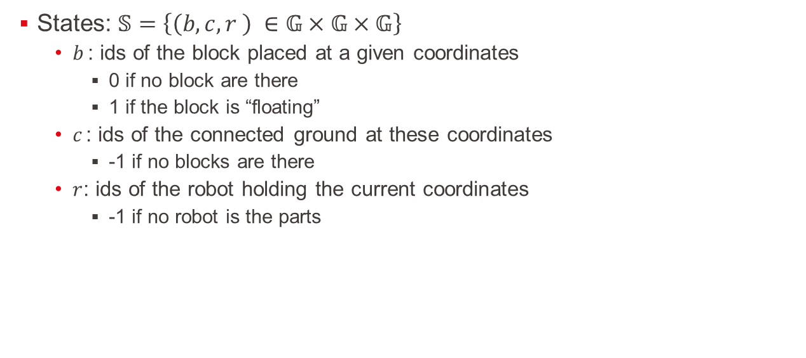
States
States: $𝕊=\left\{\left(b,c,r \right) ∈𝔾×𝔾×𝔾\right\}$
$b_{ }$: ids of the block placed at a given coordinates
0 if no block are there
1 if the block is “floating”
$c_{ }$: ids of the connected ground at these coordinates
-1 if no blocks are there
$r_{ }$: ids of the robot holding the current coordinates
-1 if no robot is the parts

Slide 52
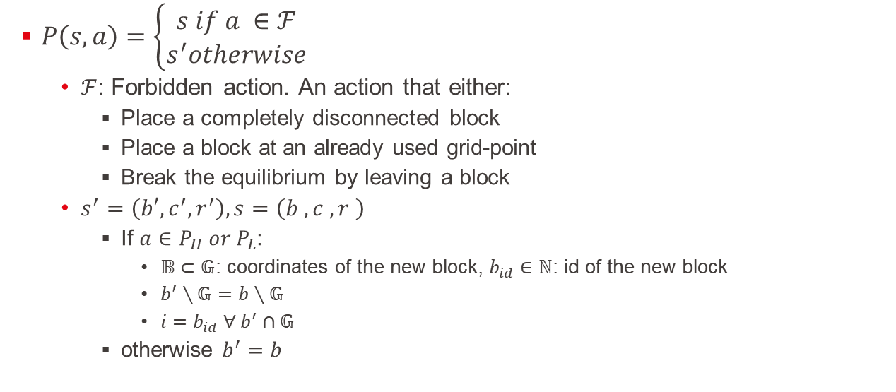
State transition
$P\left(s,a\right)=\left\{\begin{aligned}s if a ∈ℱ \\ s^{′}otherwise\end{aligned}\right.$
$ℱ$: Forbidden action. An action that either:
Place a completely disconnected block
Place a block at an already used grid-point
Break the equilibrium by leaving a block
$s^{′}=\left(b′,c_{ }^{′}, r_{ }^{′}\right),s=\left(b_{ }^{ },c_{ }^{ }, r_{ }^{ }\right)$
If $a∈P_{H} or P_{L}$:
$𝔹⊂𝔾$: coordinates of the new block, $b_{id}∈ℕ$: id of the new block
$b_{ }^{′}∖𝔾=b∖𝔾$
$i=b_{id} ∀ b^{′}∩𝔾$
otherwise $b^{′}=b$

Slide 53

State transition
$P\left(s,a\right)=\left\{\begin{aligned}s if a ∈ℱ \\ s^{′}otherwise\end{aligned}\right.$
$s^{′}=\left(b′,c_{ }^{′}, r_{ }^{′}\right),s=\left(b_{ }^{ },c_{ }^{ }, r_{ }^{ }\right)$
If $a∈P_{H} or P_{L}$:
$𝔹⊂𝔾$: coordinates of the new block, $c_{id}∈ℕ$: id of the smallest connected ground
$c_{ }^{′}∖𝔾=c∖𝔾$
$i=c_{id} ∀ c^{′}∩𝔾$
otherwise $c^{′}=c$

